Slide 1


Slide 2

Chapter 4 - Part II
Enhanced Entity-Relationship and UML Modeling
This material may be used at the beginning of the transparencies for Chapter 4. It sets the stage for looking at modeling from a general standpoint. The details of abstraction mentioned here are covered in Section 4.8, but the constraints are previously discussed in Section 3.4 already.
Copyright © 2004 Elmasri and Navathe.

Slide 3
THE BASICS
Fundamental Principle of Modeling:
  Data Abstraction
Basic Process of Modeling
  Define building blocks for
  holding groups of data
  Use rules of a data model to establish
  relationships among blocks
Add constraints - structural/ semantic

Slide 4
Part 1: Fundamentals of Data Modeling
1 Inputs to Data Modeling
2 The Process of Modeling
3 Data Modeling Abstractions
4 Classification
5 Aggregation
6 Identification
7 Generalization
8 Coverage Constraints in Generalization
9 Cardinality and Participation Constraints

Slide 5
Inputs to Data Modeling
Using the products of requirements analysis
Verbal and written communication among users and designers
Knowledge of meaning of data
  Existing Programs
  Existing Files
  Existing Documents
  Existing Reports
Application Planning / Documentation and Design

Slide 6
Overall Process of Modeling
Abstraction
Use of some modeling discipline (Data Model)
Use of a representation technique
  Language
  Diagramming
  Tools
Analysis of business rules/semantic constraints (these are typically beyond the capability of the data model)

Slide 7
Types of Abstractions
Classification A is a member of class B
Aggregation B,C,D are aggregated into A
A is made of/composed of B,C,D
Generalization B,C,D can be generalized into A, B is-an A, C is- an A, D is-an A
Specialization A can be specialized into B,C,D B,C,D are special cases of A

Slide 8
Classification Abstraction
Relationship between a class and its members
John Smith, Sheela Patel, and Peter Wang are all employees. They are all members of a class: EMPLOYEE class
EMPLOYEE
John Smith
Peter Wang
Sheela Patel
Each individual employee is a member of the class EMPLOYEE

Slide 9
Classification Abstraction (contd.)
Exhaustive enumeration of members:
MONTH
January
February
December
January, February etc. are members of the class “MONTH”
  Represents “member-of” relationship
In object-oriented modeling :
MONTH : an Object type or class
January … December : objects that belong to class MONTH

Slide 10
Classification - Class Properties
Collection of similar entities or concepts into a higher level concept
EMPLOYEE class collects all employees into one class
A class has properties called “class properties”
EMPLOYEE class has class properties - e.g., average salary, total number of employees
Each member has values for own properties (e.g. name, address, salary): called member properties

Slide 11
Aggregation Abstraction
Defines a new class from a set of classes which are identified as components of the root class
CAR
Chasis
Other
Systems
Drive-train
Wheels
Tires
Hub-Caps
Tubes
represents IS-PART-OF (component) relationship
Root class: CAR
Component Classes: Chassis, Drive-Train, Other Systems, Wheels
Root class: Wheels
Component Classes: Tires, Tubes, Hub-Caps

Slide 12
Classification and Aggregation
Classification and Aggregation are used to build schemas
Example: class Person
Representation:
Person
Name
Position
Sex
Ram
John
Carlos
Male
Female
Manager
Employee
Name, Sex, and Position aggregate into Person. They are classes themselves.
Ram, John, Carlos are classified into Name or Name is a classification of Ram, John, Carlos

Slide 13
Two Contexts for Aggregation
Aggregate two or more classes into a higher level concept. It may be considered a relationship or association between them.
Context1: CAR is an aggregate (composition) of Chassis, Drive-train, Other Systems, Wheels.
Context 2: OWNERSHIP is an aggregate (relationship) of CAR and OWNER
OWNERSHIP
CAR
OWNER

Slide 14
Identification
Identifies one concept (an instance of it) from another concept.
BUILDING
Name
Identifies
ROOM
Number

Slide 15
Generalization Abstraction
Defines a set-subset relationship between a class and a set of member classes.
Establishes a mapping (or a relationship) from the generic class to the member class (or subclass, or subset class).
EMPLOYEE
Engineer
Staff
Manager
GENERIC CLASS: EMPLOYEE
MEMBER CLASS: Engineer, Staff, Manager
Implies that all properties associated with the Employee class are inherited by the three leaf classes.

Slide 16
Data Abstraction (contd.)
Process of hiding (suppressing) unnecessary details so that the high level concept can be made more visible.
This enables programmers, designers, etc., To communicate easily and to understand the application’s data and functional requirements easily.
TYPES OF ABSTRACTION
Classification: IS-A-MEMBER-OF
Aggregation: IS-MADE-OF, IS-ASSOCIATED-WITH
Composition: IS-MADE-OF (similar to aggregation)
(A COMPRISES B,C,D)
Identification: IS-IDENTIFIED-BY
Generalization: IS-A IS-LIKE IS-KIND-OF

Slide 17
Coverage Constraints for
Generalization Abstraction
TYPE 1 : Total vs. Partial coverage
Total: The coverage is total if each member of the generic class is mapped to at least one member among the member classes
Partial: The coverage is partial if there are some member(s) of the generic class that cannot be mapped to any member among the member classes
STUDENT
(t) total
EMPLOYEE
Undergraduate
Graduate
Special
(t) total
Salaried
Hourly

Slide 18
Coverage Constraints for
Generalization Abstraction (contd.)
Partial Coverage Constraint examples:
STUDENT
(p) partial
Scholarship
Student
Fellowship
Student
EMPLOYEE
(p) partial
Engineer
Scientist

Slide 19
Coverage Constraints for
Generalization Abstraction
TYPE 2: EXCLUSIVE VS. OVERLAPPING (Disjointedness Constraint)
EXCLUSIVE constraint: A member of the generic class is mapped to one element of at most one subset class.
OVERLAPPING constraint: There exists some member of the generic class that can be mapped to two or more of the subset classes.
STUDENT
(t, e) total, exclusive
American
Foreign
STUDENT
(p, o) partial, overlapping
Graduate
Research Assistant
Aid Recipient
Foreign

Slide 20
Coverage Constraints for
Generalization Abstraction (contd.)
More examples of different combinations:
VEHICLE
(t, o) total, overlapping
Car
Van
Truck
Two-wheeler
Three-wheeler
EMPLOYEE
(p, e) partial, exclusive
Technical Stuff
Non-technical Stuff
Manager

Slide 21
Cardinality Constraints
Cardinality Constraint: Quantification of the relationship between two concepts or classes (a constraint on aggregation)
MINIMUM (A,B) = n
At a minimum, one instance of A is related to at least n instances of B.
n = 0 MIN(A,B) = 0 MIN(Person, Car) = 0
n = 1 MIN(A,B) = 1 MIN(Cust, Ship-address) = 1
n = inf. MIN(A,B) = inf. NOT POSSIBLE
n = x (fixed) MIN(A,B) = x MIN(Car, Wheels) = 4

Slide 22
Cardinality Constraints (contd.)
MAXIMUM (A,B) = n
At a maximum, one instance of A is related to at least n instances of B.
n = 0 MAX(A,B) = 0 DOES NOT ARISE
n = 1 MAX(A,B) = 1 MAX(Cust, Ship-address) = 1
n = inf. MAX(A,B) = inf. MAX(Cust, Orders) = inf.
n = x (fixed) MAX(A,B) = x MAX(Stud, Course) = 6

Slide 23
Participation Constraints
MIN (A,B) = 0 Optional Participation
MIN (A,B) = 1 Mandatory Participation
MAX (A,B) = 0 No Participation
MIN (A,B) = x, MAX (A,B) = y Range Constrained
Participation

Slide 24
Summary of Modeling Concepts
ABSTRACTIONS
  CLASSIFICATION
  AGGREGATION (COMPOSITION AND ASSOCIATION)
  IDENTIFICATION
  GENERALIZATION AND SPECIALIZATION
CONSTRAINTS
  CARDINALITY (Min. and Max)
  PARTICIPATION
  COVERAGE (Total vs. Partial, Exclusive vs. Overlapping)

Slide 25
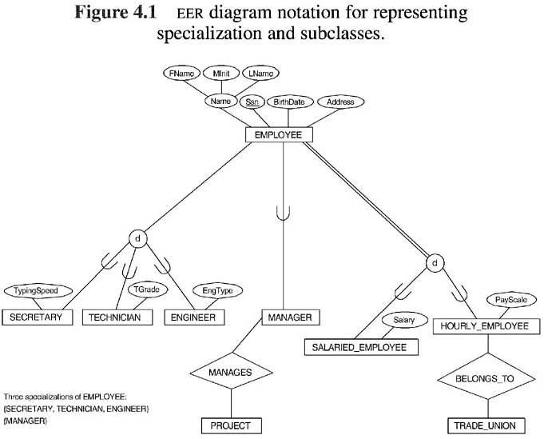

Slide 26
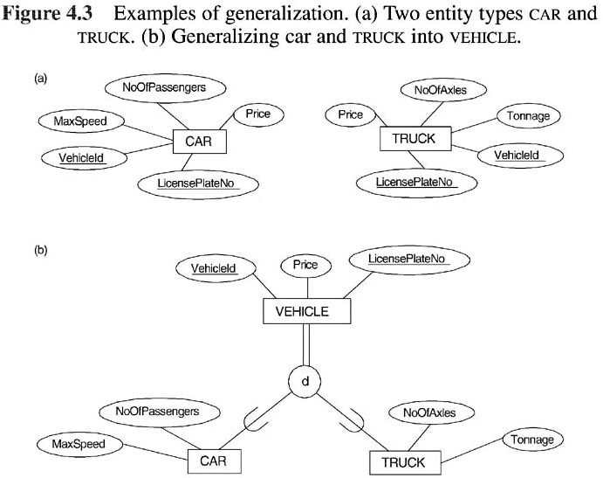

Slide 27
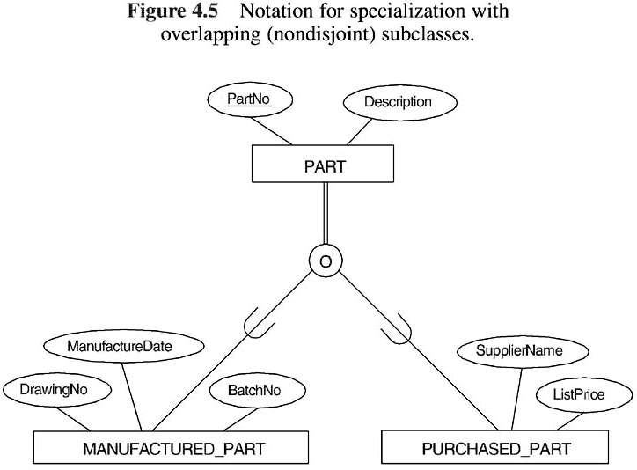

Slide 28
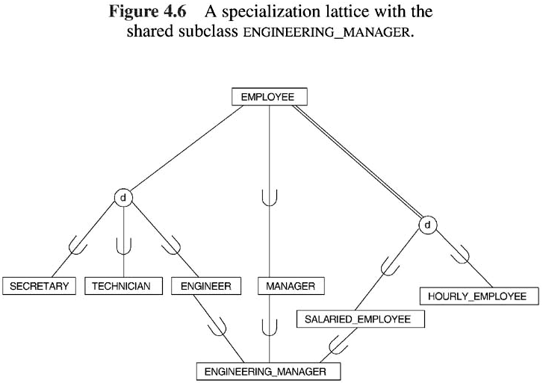

Slide 29
